Slide 1
Employee Data Analysis using Excel
STUDENT NAME: SANDHIYA. R
REGISTER NO: 312209934(asunm1363312209934)
DEPARTMENT: B.com Bank Management
COLLEGE: Valliammal College for Women

Slide 2

PROJECT TITLE
Employee Performance Analysis using Excel

Slide 3


AGEND
Problem Statement
Project Overview
End Users
Our Solution and Proposition
Dataset Description
Modelling Approach
Results and Discussion
Conclusion
3/21/2024 Annual Review

Slide 4

PROBLEM STATEMENT
Utilize Excel to efficently analyse employee data by leveraging Function such as Pivot tables, and conditional formatting.
The enables the identification of key trends, such as current Employees rates, performance levels.
It helps to visualize the data through pivot chart.

Slide 5

PROJECT OVERVIEW
This project focuses on analysing employee data to identify trends andAnd insights that can drive better decision.
Excel will be used to clean, organize, and visuzalise kry metrics such asEmployee demographics, performance, and rention rates.The analysis will highlights areas of improvemnet in workforce management Help to optimize resource allocation.
The aim of this project is to support stratergic planning.

Slide 6
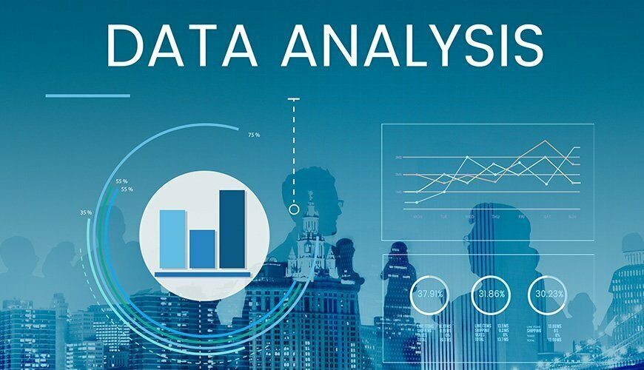

WHO ARE THE END USERS?
The end users of the employee data employee data analysis are HRManagers team leads and senior management.

Slide 7

OUR SOLUTION AND ITS VALUE PROPOSITION
Conditionals formatting – highlights missing cells
Filters – helps to remove the empty cells
Formulas – helps to identify the performance of employees
Pivot table – helps summarize
Pie chart – shows the data

Slide 8
Dataset Description
Employee ID
First name
Last name
Business unit
Employee classification type
Employee type
Gender
Work location

Slide 9

THE "WOW" IN OUR SOLUTION
Conditional formatting
That helps in filling the colour in missing cells
Filter by colour
That filters the cell by sort out by colour
Pivot chart
That helps to visualize the data in simple way
3/21/2024 Annual Review
9

Slide 10
MODELLING
DATA COLLECTION :
*Identification
*Gathering
*Preparation
DATA CLEANING :
*Standarization dization
*Correction
*Validation
SUMMARY :
Data analysis involves examining, transforming, and modeling data to Extract insights , identify patterns, and support decisions-making.
10

Slide 11
RESULTS
11

Slide 12
CONCLUSION
IN CONCLUSION,
The employee data analysis conducted using Excel Provided valuable insights into workforce trends enabling more Infromed decision-making.
The use of Excel allowed efficient data organization, visualization and reporting, ultimately helping to enhance HR strategies, improve and employee satisfaction and optimize overall organizational performance.

